Slide 1


Harvard Referencing

Slide 2
Referencing
How would you rate your referencing skills?
1 = Very bad
10 = Excellent

Slide 3

Learning Objectives
By the end of this session, you will be able to:
Describe the purpose of referencing
Reference books and websites within your assignment
Create a bibliography
Reflect on referencing abilities
Skills
  Listening
  Communication
  Teamwork

Slide 4
What is Harvard Referencing?
The Harvard referencing system is a way of allowing your tutor to see what sources of information you have used to put together your piece of work.
A reference is giving credit to the author who wrote the ideas that you have used.

Slide 5

Why Reference?
Show you have done some reading/ research
Give work some authority/ credibility.
Show which resources were used – then you can go back to them if you need to.
Practice for Further / Higher education.
Avoid plagiarism!

Slide 6
References
Inside the essay as you are writing.
In-text citations
At the end of your essay under a list called a Bibliography or Reference list.

Slide 7

Referencing within your assignment
(In-text citations)
It is good practice to use references (brief quotes) in your work
When you take a direct quote from someone.
When you are putting it in your own words.

Slide 8
In-text citations:
Direct quotations:
Jones (2012, p.245) stated that “many of the facts in this case are incorrect.”
or – “Many of the facts in this case are incorrect” (Jones, 2012, p.245).
Indirect references (paraphrases):
It is important to consider the accuracy of all facts in each case as outlined by Jones (2012, p.245).

Slide 9


In-text citations
Put quotes in to your essay to help you make your points.
Use quotes to back up your arguments.
Try and take quotes from books AND websites

Slide 10

Bibliography/ Reference List
References must be listed in detail at the end of your work on a separate sheet - Bibliography or ‘reference list’
An alphabetical list by author.

Slide 11

Books (Bibliography)
Edition
Title
Author

Slide 12

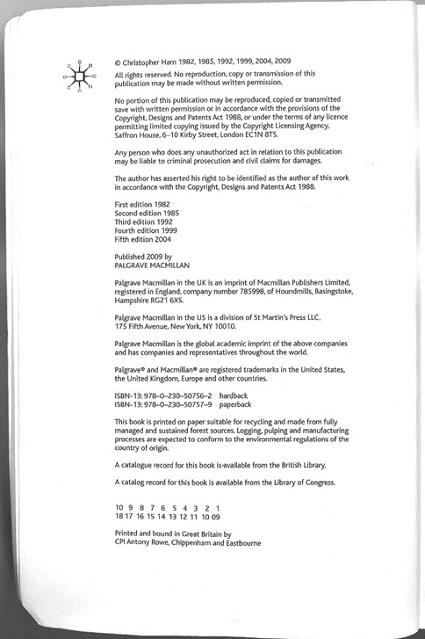
Books (Bibliography)
Publisher
Year
Place of publication (town/city)

Slide 13

Books and ebooks (Bibliography)
Author’s surname, Initial. (Year of Publication)
Title in italics. edition. Place of publication:
Publisher.
e.g.
Ham, C. (2009) Health Policy in Britain. 6th edn.
Basingstoke: Palgrave.

Slide 14
Four or more authors
‘et al’ means ‘and others’.
Chaffey et al. (2011, p. 85) state that……
You must put all authors in your bibliography.
Chaffey, D., Mayer, R., Johnstone, K. and Ellis-Chadwick, F. (2011) Marketing. London: Penguin.

Slide 15

Referencing Websites

Slide 16
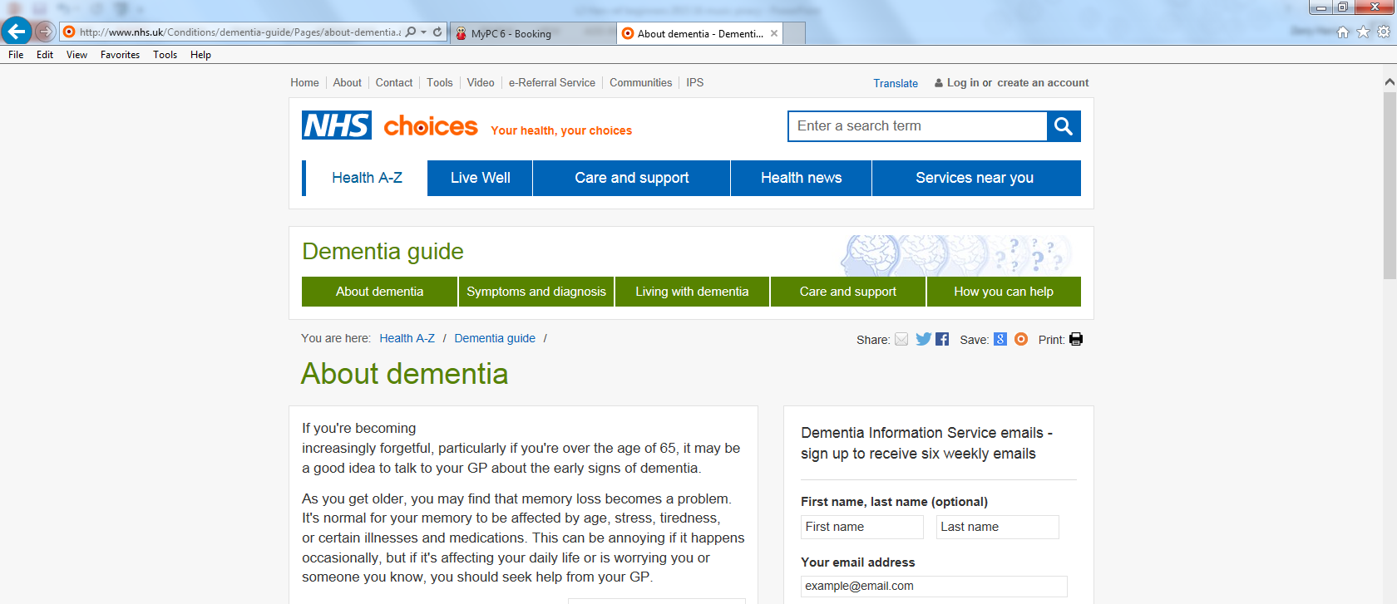
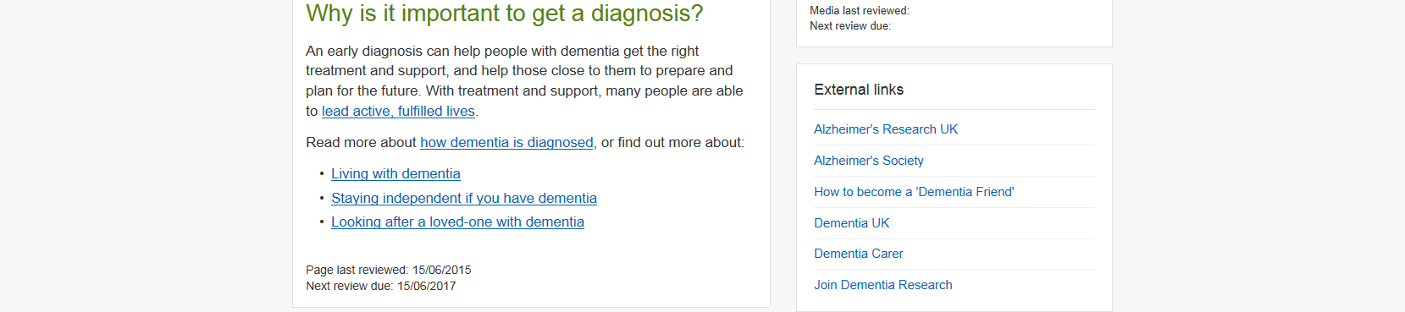
Electronic address
Author of webpage
Title of webpage
Year of publication
Date you accessed the source

Slide 17
Website (Bibliography)
Author (Year of publication) Title in italics. Available at: web link (Date accessed).
Department of Health (2016) A practical guide for disabled people or carers. Available at:
http://www.doh.gov.uk/disabledguide/index.htm (Accessed: 26 May 2016).

Slide 18

Referencing a Website within your assignment
Use the name of the person or organisation responsible for the site.
Use the date of the site's creation or most recent update.
Example: NHS states…(2019)
Example: (BBC, 2019)
Example: (DoH, N/D)

Slide 19
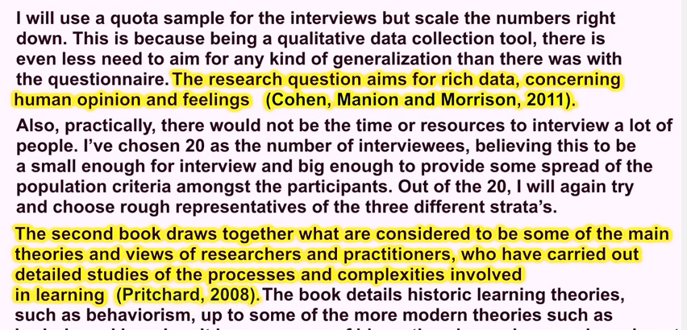
Two types of referencing
In-text citations (within your work)
Cohen, L., Manion, L. and Morrison, K. (2011) Research Methods in Education. 7th edn. London: Routledge.
Pritchard, A. (2008) Ways of Learning. Learning Theories and Learning Style in the Classroom. 2nd edn. Oxon: Routledge.
Bibliography
(or Reference list)

Slide 20

Quick test:
Can you reference books and websites?
Books
Websites

Slide 21
Task
Once you have tried to reference a book and a website ask a peer to check your reference
Then ask your tutor to check

Slide 22
Reflection
Now how would you rate your referencing skills?
1 = Very bad
10 = Excellent

